Slide 1

Optimization of the Social Force Model Jiajun Jiang Kehong Liu Jiaqing Xie Peiyuan Xie
TexPoint fonts used in EMF.
Read the TexPoint manual before you delete this box.: AAAAA

Slide 2
General Remarks
Pay attention to the length: e.g., 10 minutes typically means 7–8 slides
Use proper visuals as much as possible, avoid text-only bullet slides
Don’t put an overview or organization slide – the talk is too short
For the very motivated, check out this small guide http://people.inf.ethz.ch/markusp/teaching/guides/guide-presentations.pdf

Slide 3
Typical Organization I
Algorithm that you consider (maybe 2 slides)
State problem that it solves (input:…, output: …)
If possible visualize how it works or show high-level pseudocode
State asymptotic runtime
Cost analysis (cost measure, exact count)
Baseline implementation (briefly explain), maybe show already performance plot and extract percentage of peak
Optimizations you performed
Briefly discuss major optimizations/code versions
Maybe explain the most interesting in a bit greater detail
Any analysis (e.g., profifling) you performed is interesting – show the result
If too much, explain only some things and just state the rest

Slide 4
Typical Organization II
Experimental results
Very brief: Experimental setup (platform, compiler)
Performance plot over a range of sizes with different code versions
Make sure you also push input size to the limit in the experiments
Extract overall speedup
Every project is different – so adapt as needed
Focus on the most interesting things, don’t explain everything that will be in the final report.

Slide 5
Try to Make Nice Plots
DFT 2^{n} (single precision) on Pentium 4, 2.53 GHz
[Gflop/s]
Spiral SSE
Intel MKL
Spiral C vectorized
Spiral C
n

Slide 6
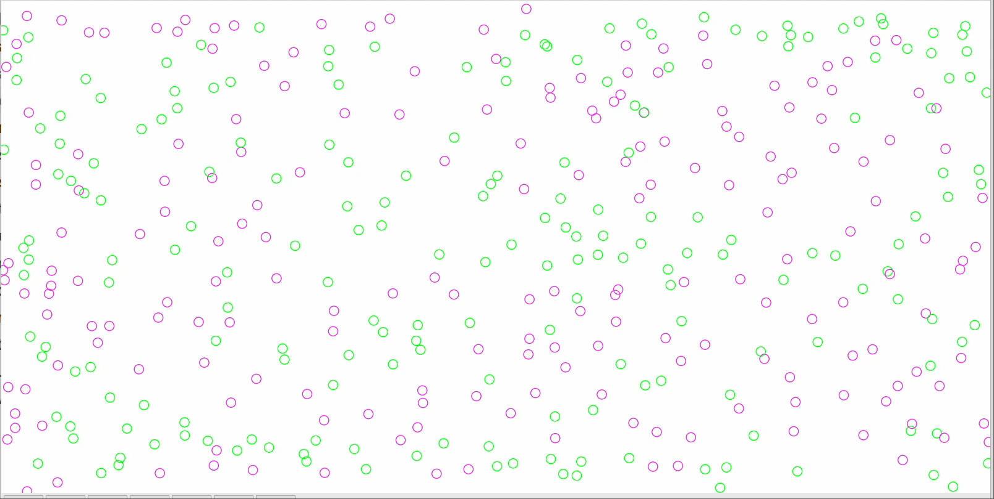
The Social Force Model
Simulates pedestrian motion by computing the attractive and repulsive forces between pedestrians, building, etc.
Input: Initial pedestrian positions, velocities
Output: A sequence of pedestrian positions, velocities

Slide 7
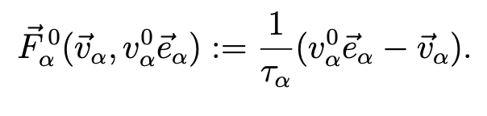
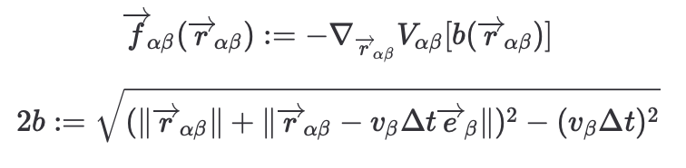
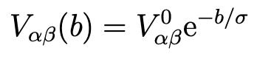
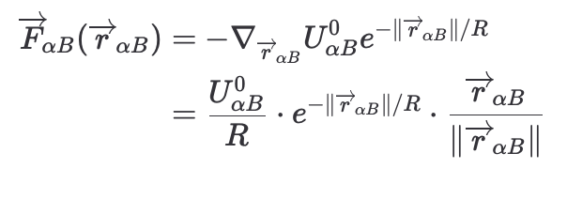
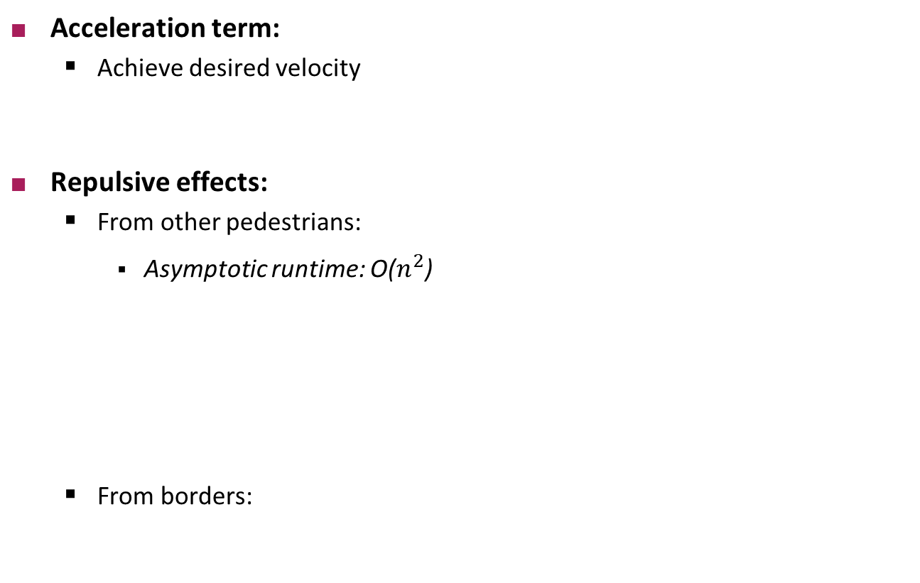
The Social Force Model
Acceleration term:
Achieve desired velocity
Repulsive effects:
From other pedestrians:
Asymptotic runtime: O($n^{2}$)
From borders:

Slide 8
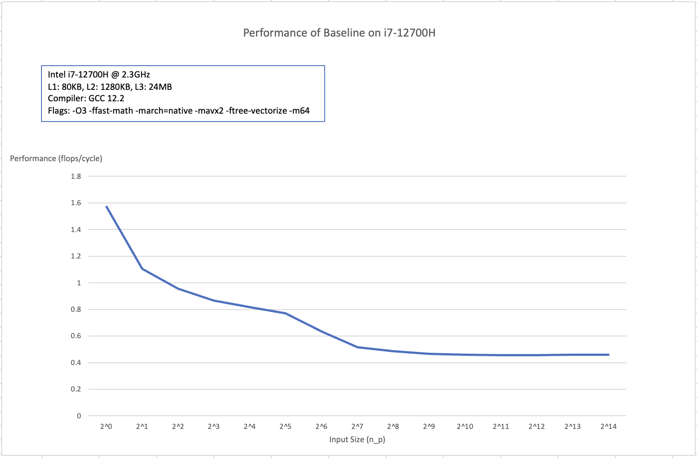
Cost Analysis and Baseline Implementation
The cost is measured in terms of flops/cycle
Counted the number of flops by hand: n*(59+52*n) flops
Timed the number of cycles using a custom timing framework
Notes:
Baseline performance is far from peak: ~8% of peak performance on large inputs

Slide 9
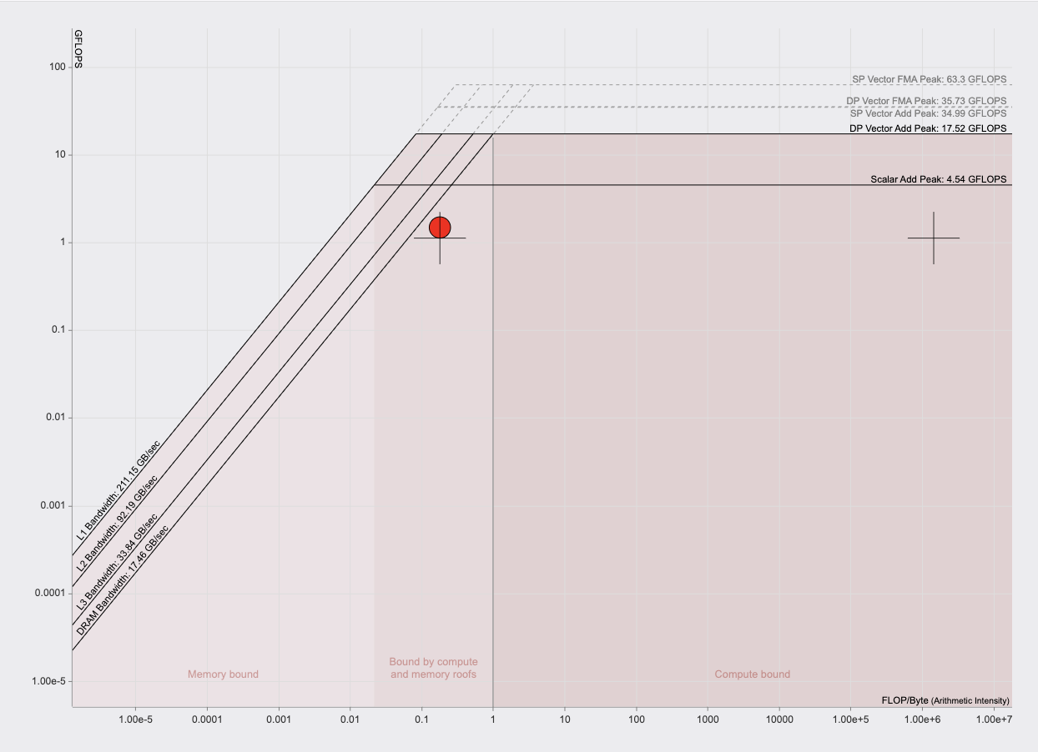
Baseline Implementation Analysis
Analysis using Intel VTune indicates majority of the time is spent computing repulsive forces between pedestrians
Roofline model using Intel Advisor indicates the computation is fundamentally compute bound (for datasets that fit in cache), but also affected by memory transfers

Slide 10
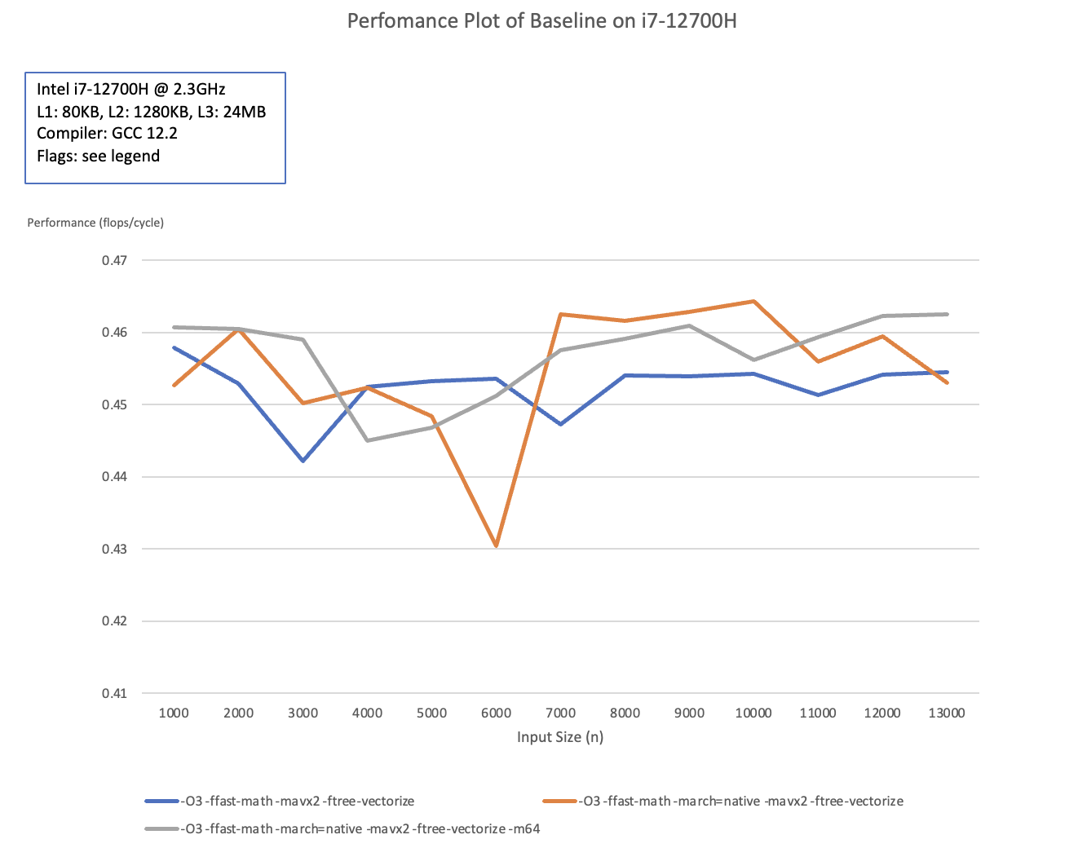
Optimization 0: Compiler Flags
All measurements are taken on Ubuntu 20.04, i7-12700H @ 2.3GHz, turbo boost disabled
-O3 -ffast-math -march=native -mavx2 -ftree-vectorize -m64 used for all further compilations

Slide 11
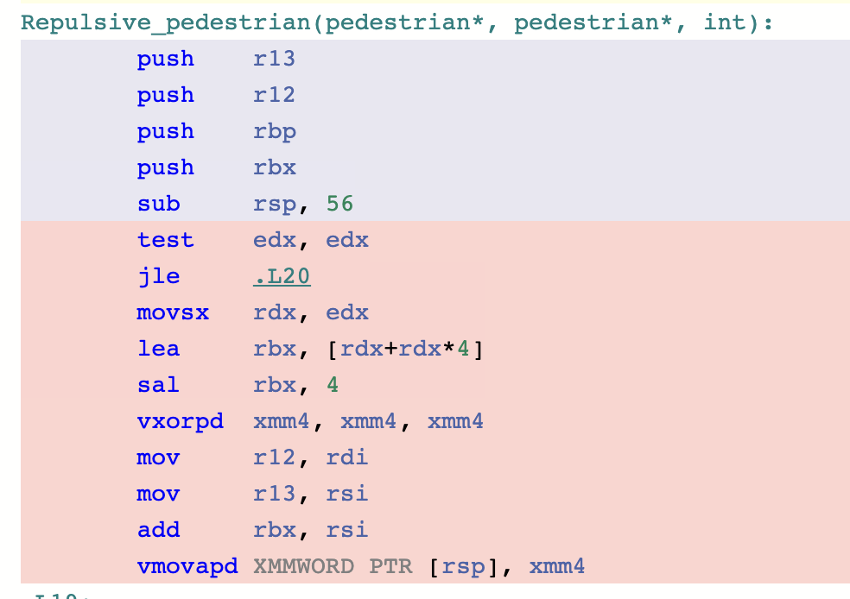
Baseline Implementation Analysis
Compiler did not vectorize the code much, although –ftree-vectorize flag is used

Slide 12
Optimization 1: Inlining, precomputation, strength reduction
Inlined procedure calls and noticed many repeated computations: lifted out of the loop
Used faster algorithm for expensive operations such as inverse square roots
Unrolled loops, improved performance
# of flops increase, but since used cheaper operations, speed increased

Slide 13
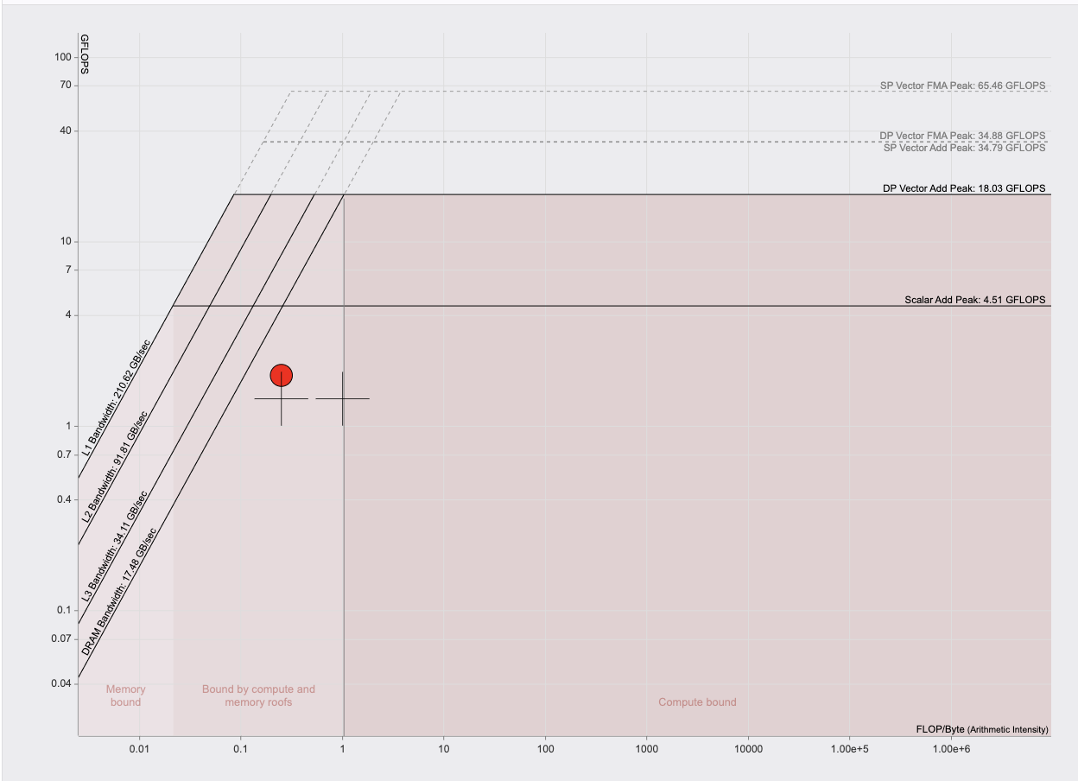
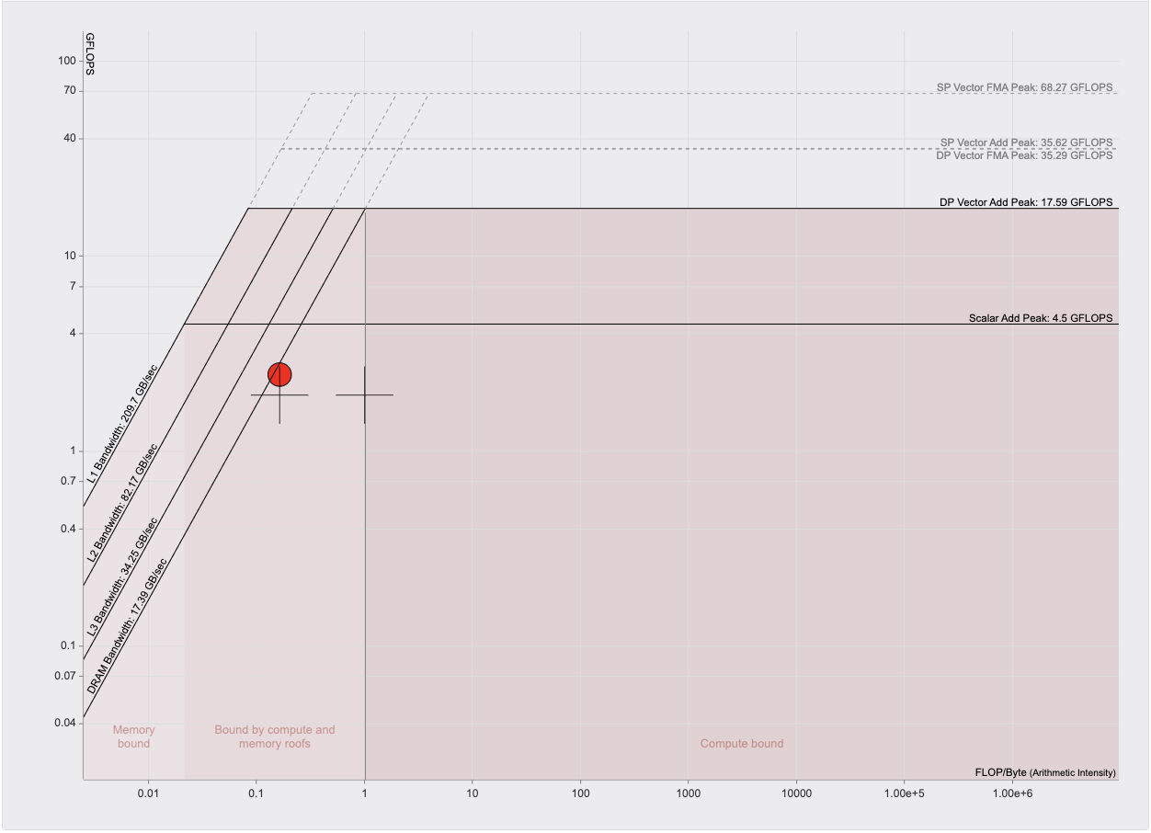
Optimization 1 Results
Without unrolling (optimized_3)
With Unrolling (optimized_4)

Slide 14
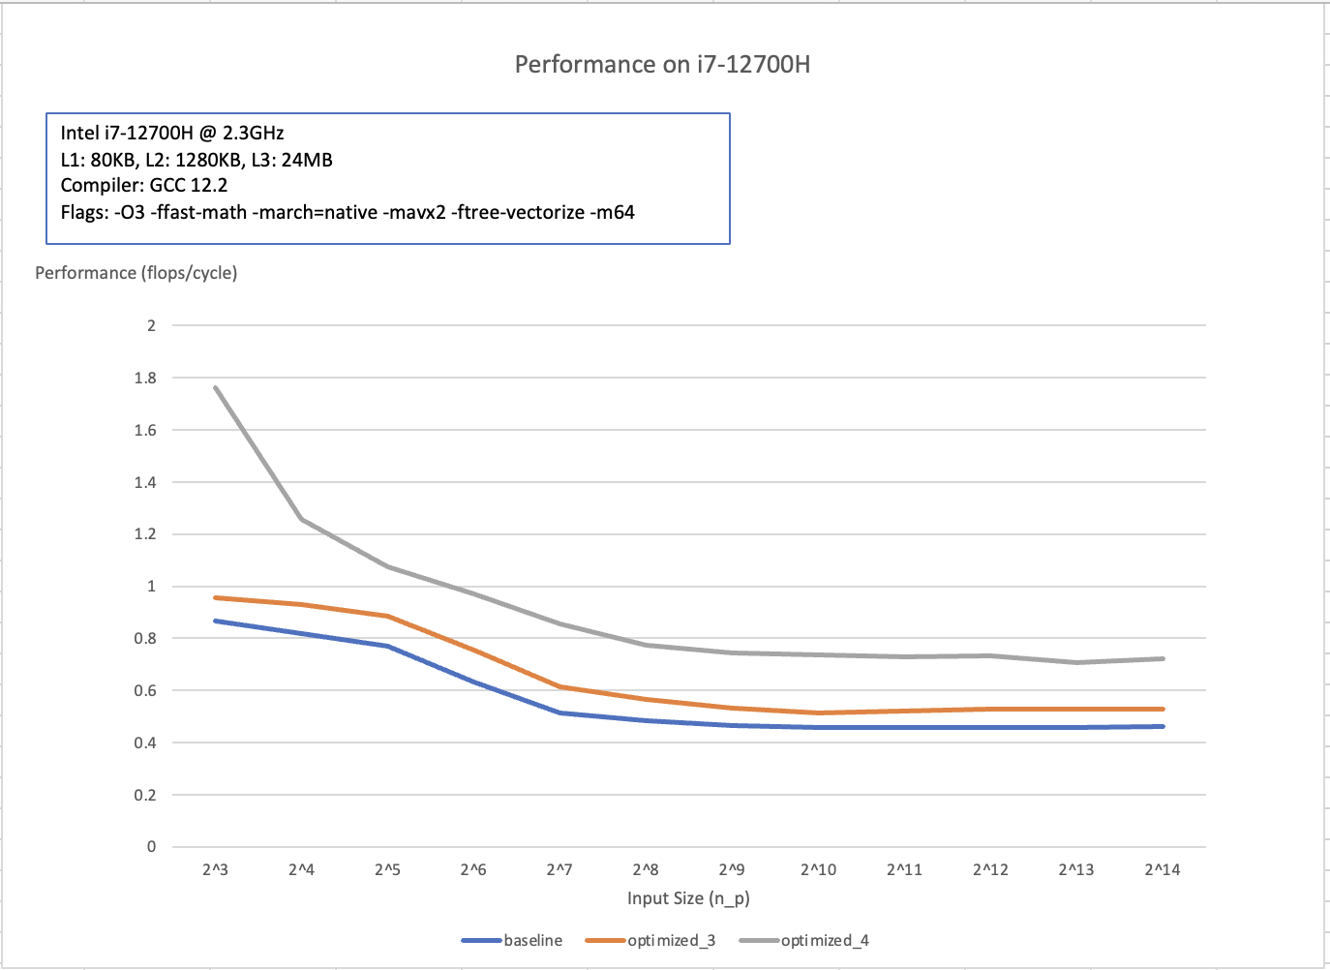
Optimization 1 Results
Noticeable performance improvement compared to baseline, still long way to go

Slide 15
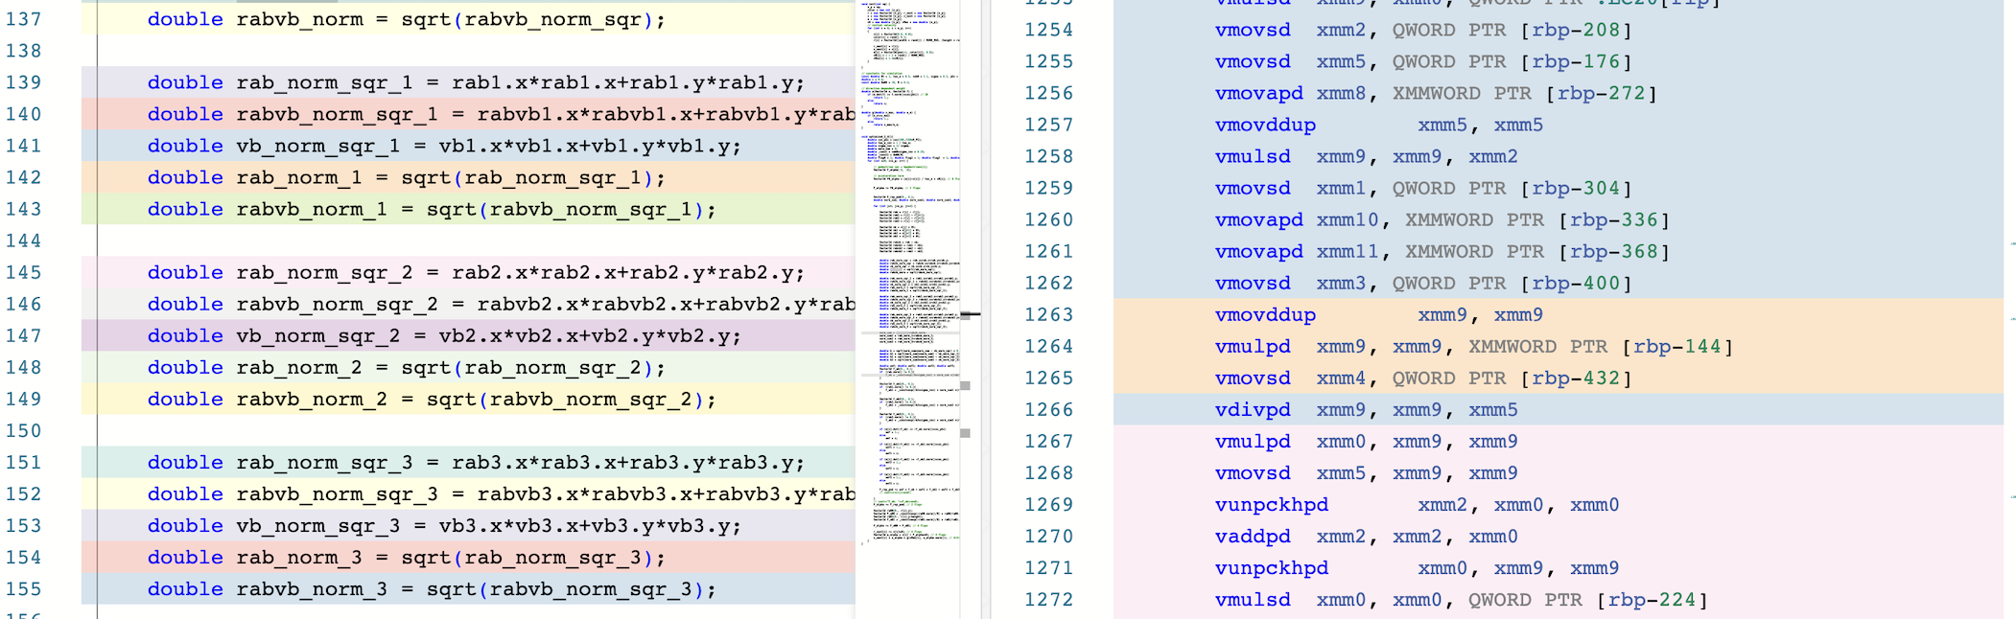
Optimization 2: Using arrays
Changing AoS to SoA alone did not improve operational intensity, but allowed compiler to perform vectorization: much higher performance and much faster when combined with compute optimizations
Possible reasons for locality not improving: test datasets all fit in cache, thus locality does not help much
Notes:
Baseline implementation uses array of structs of ~80 bytes, block size = 64 bytes, Repulsive_pedestrian iterates over the array and compute on certain fields → no spatial locality
The outer computation iterates over n_p pedestrians, inner loop in Repulsive_pedestrian also iterates over n_p pedestrians → no temporal locality
Therefore: use SoA
Perf: no less cache misses
Can’t test dataset that are too large, takes way too long

Slide 16
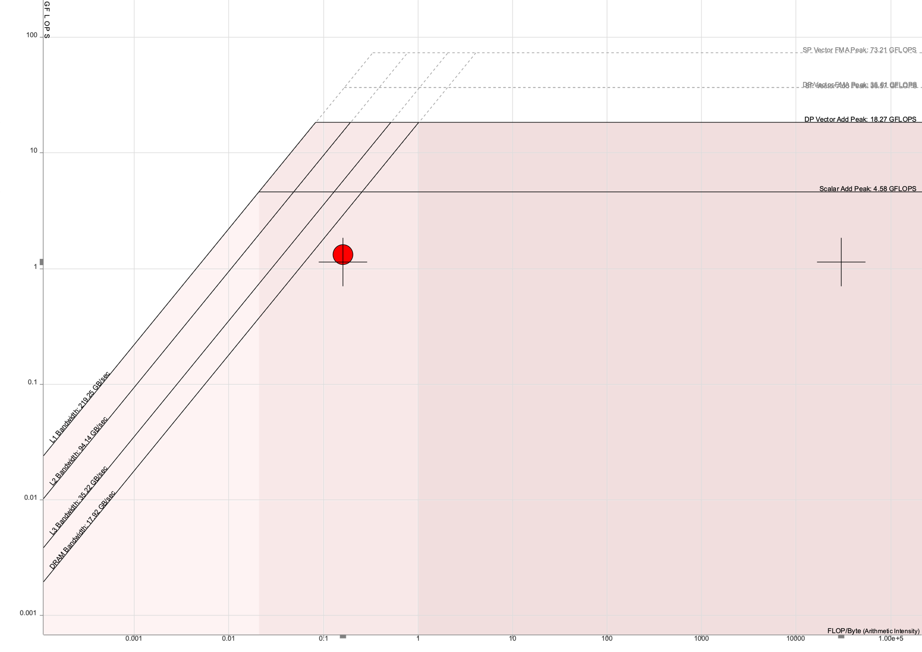

Optimization 2 Results
SoA + unrolling + precomputation (soa_optimized_3)
SoA only (soa_baseline)
Notes:
Soa_opt_3 vectorized, soa_baseline still scalar

Slide 17

Optimization 2 Results
SoA + unrolling + more precomputation
(soa_optimized_3_4)

Slide 18
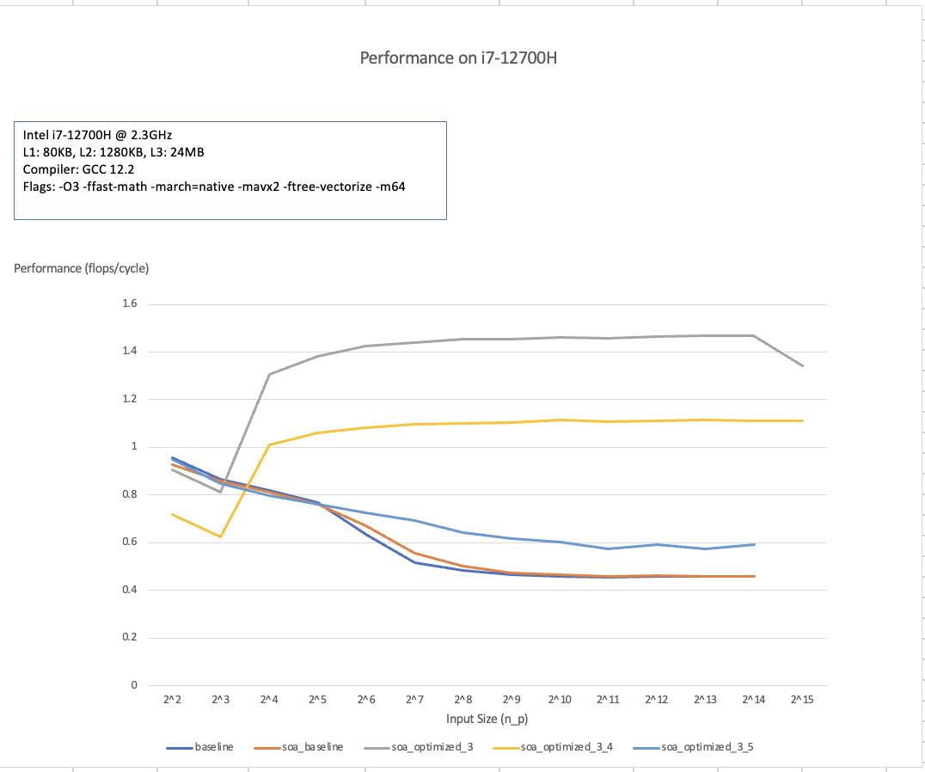
Optimization 2 Results
Notes:
Soa_opt_3: best performance
Soa_opt_3_4: lower performance, but less flops, thus actually faster
Soa_opt_3_5: fast inv sqrt does not help, and not vectorized

Slide 19
Optimization 3: AVX Intrinsics
Changing to SoA also allows for easier use of intrinsics
Instead of dealing with interleaved doubles and ints, just load values and perform computation
Assumption: input size is divisible by 4
Changed compiler to ICPC to enable the use of more intrinsics

Slide 20
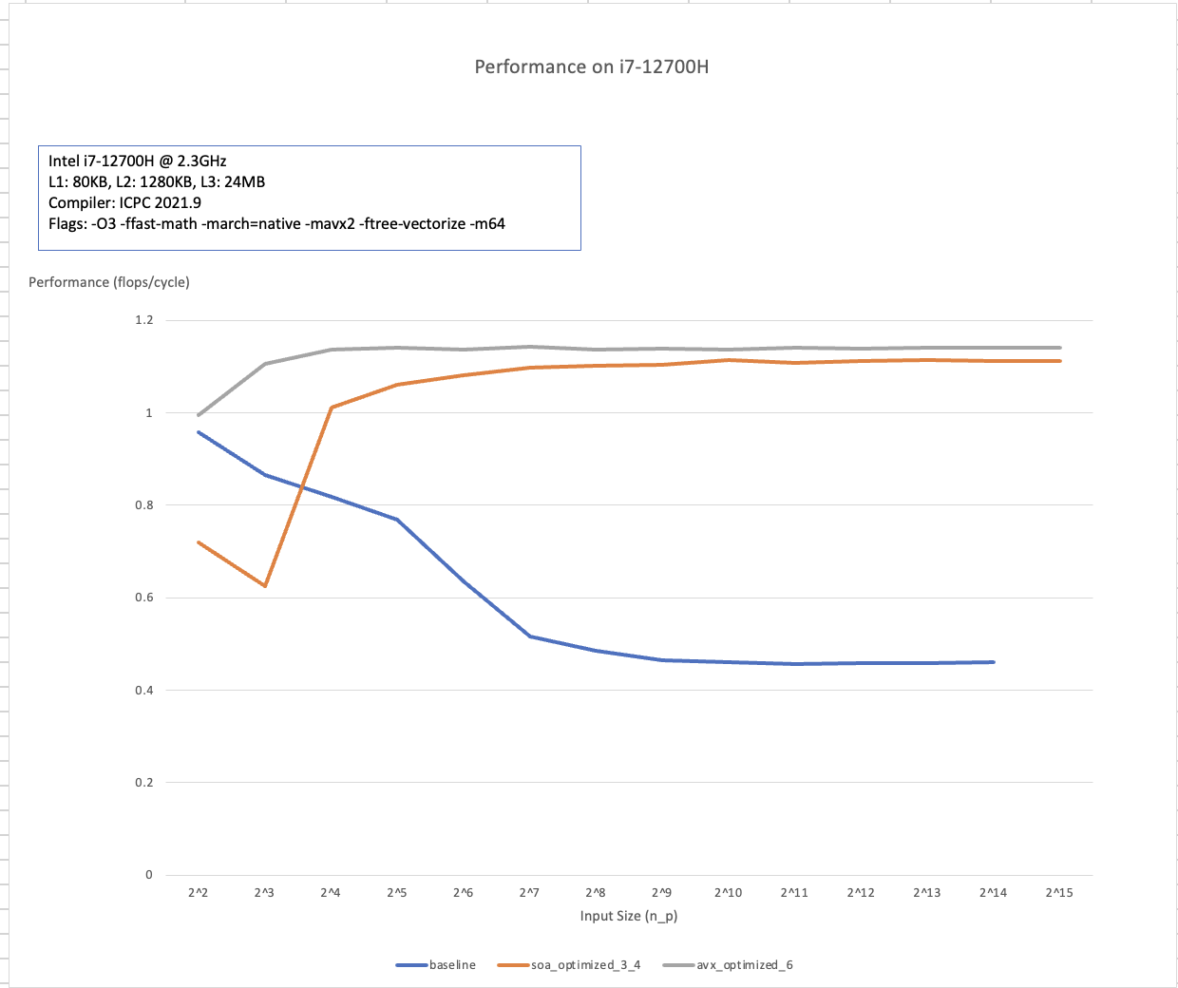
Final Results - Performance
2.5x Performance increase

Slide 21
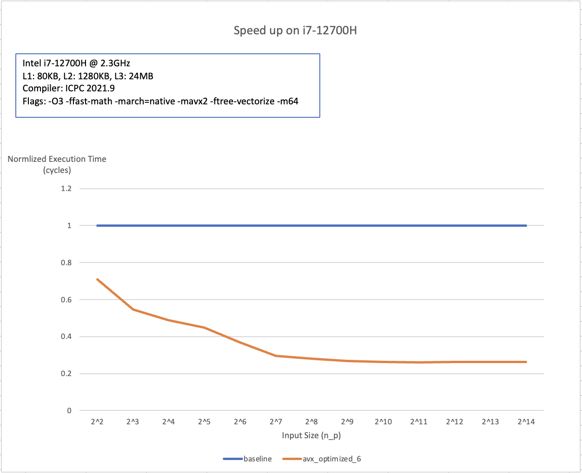
Final Results: Speed up
4x speed up using AVX

Slide 22
The End Thank you!

